Slide 1














End User Essentials
Version 6.3
© ThoughtSpot Inc 2019

Slide 2
Learning objectives
Learn what ThoughtSpot is
Use and save Answers and Pinboards
Master basic searches
Change the chart
Format a chart
Drill down to the detail level of data
Use filters
Ask An Expert
Mobile Demonstration
Notes:
This deck introduces the basics of searching using ThoughtSpot. It is part 1 of 2 of end user functionality training. By the end of this presentation, you will be able to navigate ThoughtSpot, do basic searches, use filters, and access saved Answers and Pinboards.

Slide 3
What is ThoughtSpot?

Slide 4
A way to get fast answers from your data,
rather than just a reporting tool.
Notes:
ThoughtSpot is a search and AI-Driven analytics platform. Our focus is on making analytics 100x easier and more accessible for the masses. While a lot of noise has been made in the past few years around big data and data scale, we’re looking at the data challenge from a human-scale perspective. Our big question is, how do you get more people access to the data they need to do their jobs everyday? We can all relate to needing a report for a project, and by the time the report is prepared we have forgotten we ever requested it. Or perhaps we’re the one pulling the report and we know it’s never going to get used!
At ThoughtSpot, we believe it’s possible for everyone in your organization to access their data and uncover the insights that they need faster than ever before.

Slide 5
ThoughtSpot uses search, because it is familiar
Easy to Use
Instant Response Time
No More Waiting for Experts
Notes:
ThoughtSpot uses a search bar that allows you to explore your data. Most users are familiar and comfortable using a search bar; it’s easy, fast, and doesn’t rely on waiting for an analyst to run a report. It gives business users the power to answer their own questions.
ThoughtSpot enables you to view and analyze your data through a search-based user interface. You can create your searches quickly and easily, just by typing them into a search bar, like you do when using an internet search engine. ThoughtSpot makes it easy to see your data, get your questions answered, create interactive graphs, and customize pinboards. You don’t need to understand how ThoughtSpot stores information or know SQL to do these things. Collaboration and security features make it easy to protect sensitive data and safely share information with others.

Slide 6
Introduction

Slide 7
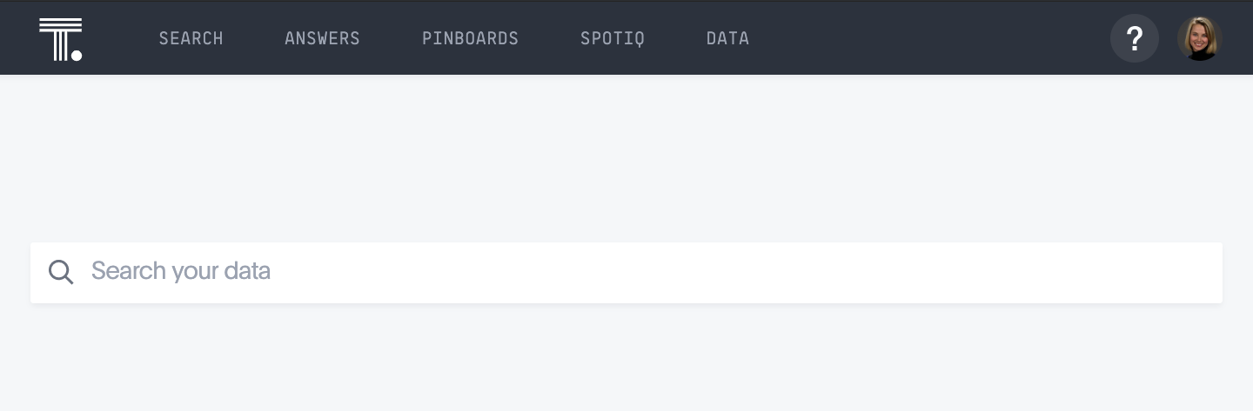
The Top Menu Bar
Create a new search
View Answers and Pinboards
Find automatically generated insights and analysis
Upload, manage, and configure data
Set password and manage profile
Notes:
ThoughtSpot is organized into several sections to make navigation easy.
Search is where you can search and explore your data. Choose your data sources and type in the search bar at the top. As you type your search, results will appear in the main part of the screen as either a table or a chart.
Answers are the result of a single search. You can save an answer you want to work more on later, or just keep it for your personal use. Answers are for you alone, until you share them with others.
Pinboards are collections of related search results. You can create your own pinboard or add to an existing one. Once a pinboard has been saved, it can be shared with others or viewed as a slideshow. The Pinboards page shows a list of saved pinboards. Click one to view, edit, or share it.
You can go here to view the status of your request after you choose Auto Analyze or Custom Analyze, and to see the results.
Data contains a list of data sources. These are usually loaded and managed by your administrator. However, you may be able to import a spreadsheet (Excel or CSV) here, if you have the correct privileges.
If you have administrator privileges, the Admin menu will appear after Data.
The Help icon, a question mark, is where you can find information and support resources for ThoughtSpot. You can also find the support contact information and software version number here.
The user icon allows you to either view your preferences or log out. You can also change your icon here.

Slide 8
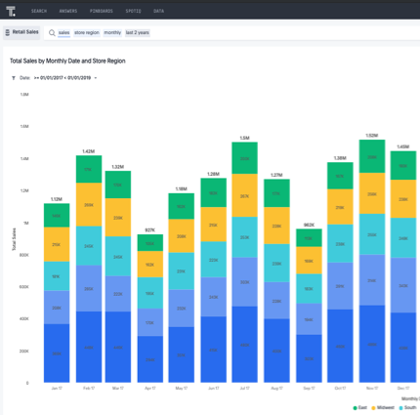
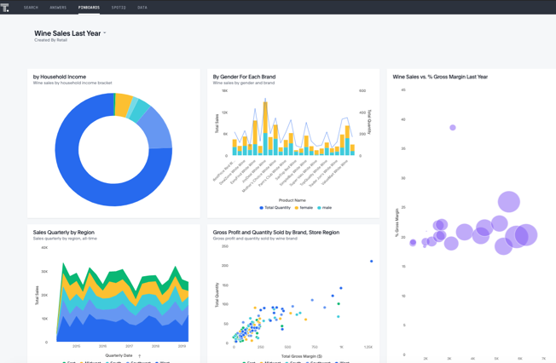
Answers and Pinboards
ThoughtSpot always shows live data, based on the frequency of the data refresh. Answers and Pinboards always auto-updated with the latest data.
Answers
Save a standalone search result
Share a single search result
Save your work in progress
Pinboards
Make a collection of related charts and tables
Filter many charts and tables at once
Present as a slideshow

Slide 9
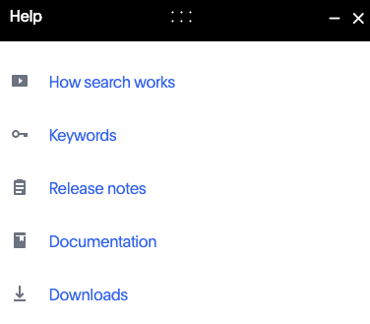
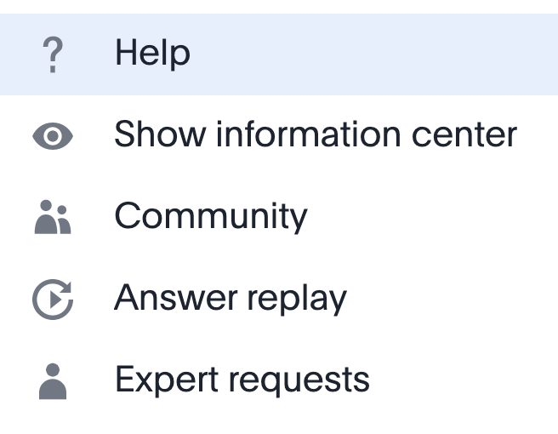
Help
The Help page of the top bar includes links to additional resources, including information regarding documentation, keywords, and search.
Notes:
The Help icon, a question mark, is where you can find information and support resources for ThoughtSpot. There are short videos, a keyword reference, links to documentation, and other useful materials. You can also find the support contact information and software version number here.
How search works is a short video that explains how to use the Search bar.
Keywords is a product keyword reference.
Release notes include the notes for the ThoughtSpot version.
Documentation links to ThoughtSpot’s documentation set.
Downloads contains a list of software downloads, such as connectors.
Along the bottom of the Help screen you’ll see a link to contact Support as well as the version of ThoughtSpot you are using.

Slide 10
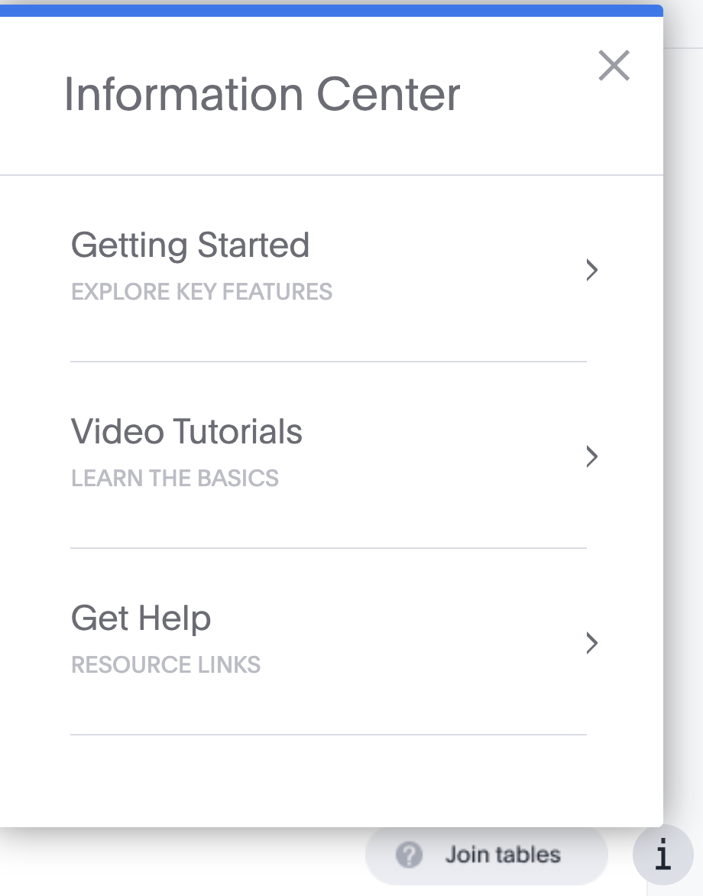
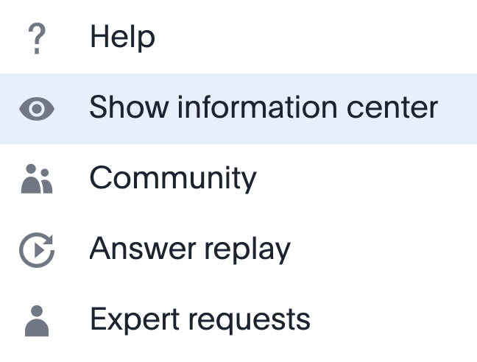

Help: Information Center
Notes:
ThoughtSpot offers in-product guidance and video content to quickly onboard new users and teach them how to effectively use ThoughtSpot. Users can select Show Information Center from the ? icon to show the “i” icon at the bottom of the page. Clicking this icon will list the training lessons available to the user.

Slide 11
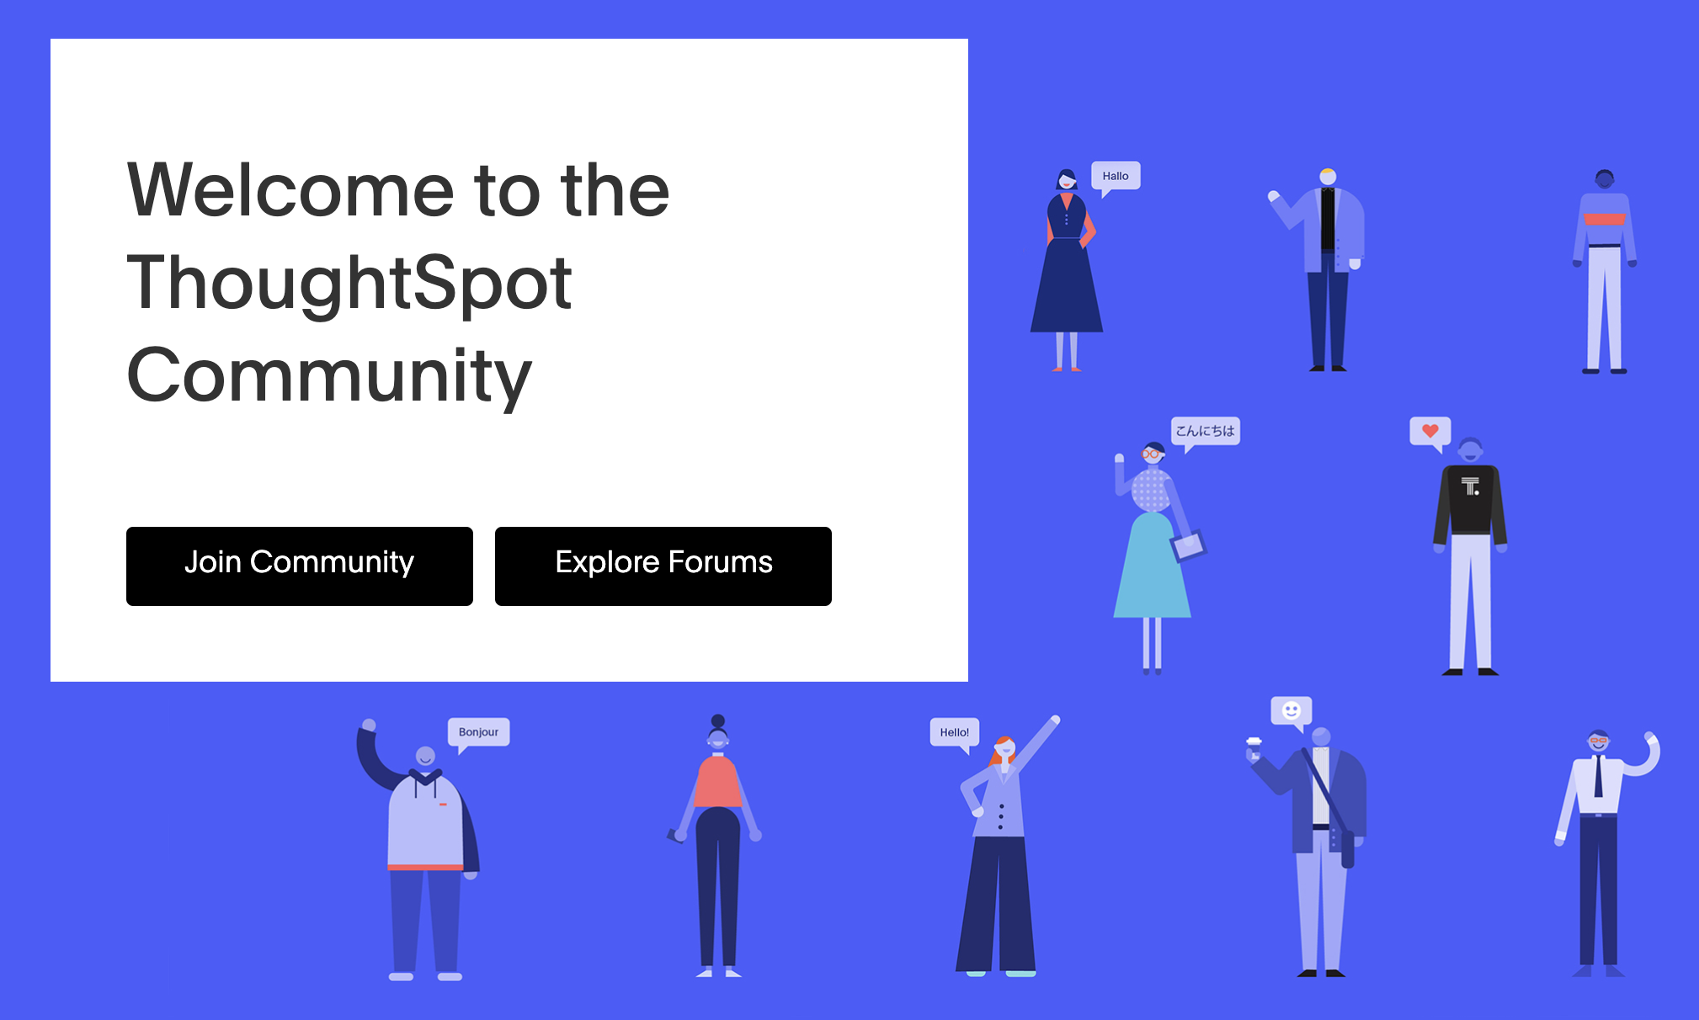
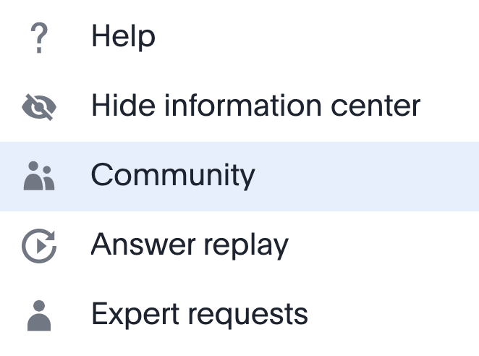
Help: Community
Notes:
Community is a link to community.thoughtspot.com, where you can find answers to your questions, share best practices, contribute feedback for the ThoughtSpot Product team, submit a help ticket, and feel empowered to take your data to the next level.

Slide 12
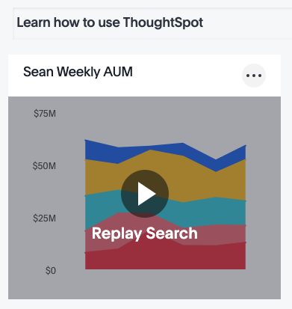
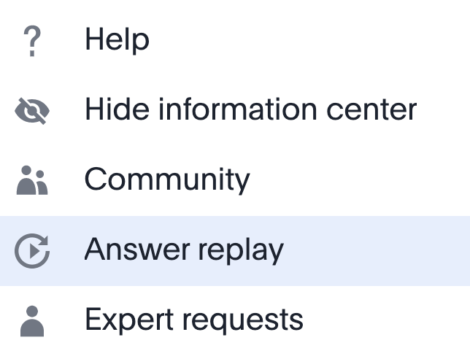
Help: Answer replay
Notes:
Clicking Answer Replay from the Help menu takes you to the Learn How To Use ThoughtSpot Pinboard, which allows users to replay searches for Answers that Administrators have pinned to this learning Pinboard.

Slide 13
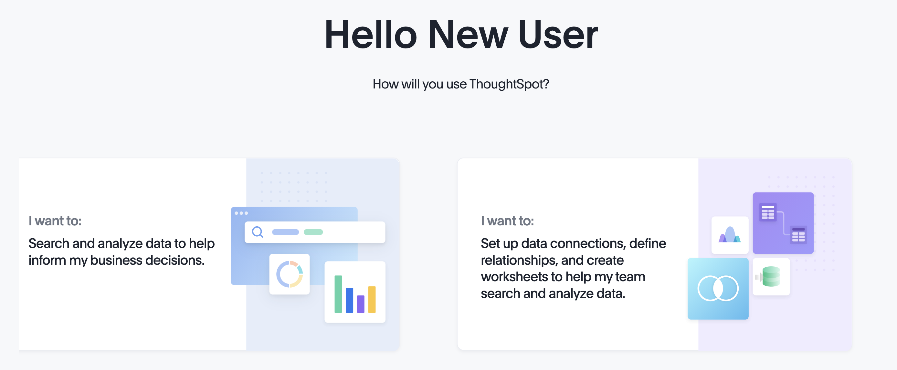
User Onboarding
An new user onboarding experience begins when you log in for the first time. This series of pages introduces the new user to search, working with data sources, using Pinboards, and viewing insights.
Notes:
When you begin using ThoughtSpot, the onboarding process starts automatically and guides you through a few basic scenarios. Usually, you receive an email welcoming you to the onboarding process at ThoughtSpot. To repeat user onboarding, see Revisit Onboarding in the user profile. This feature may be turned off for new users.

Slide 14
Search

Slide 15
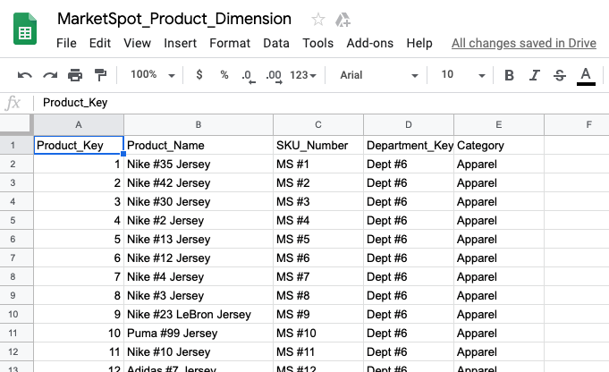
What are you searching?
We search data tables, or spreadsheets, which are comprised of rows and columns. Headers describe what each column contains.

Slide 16
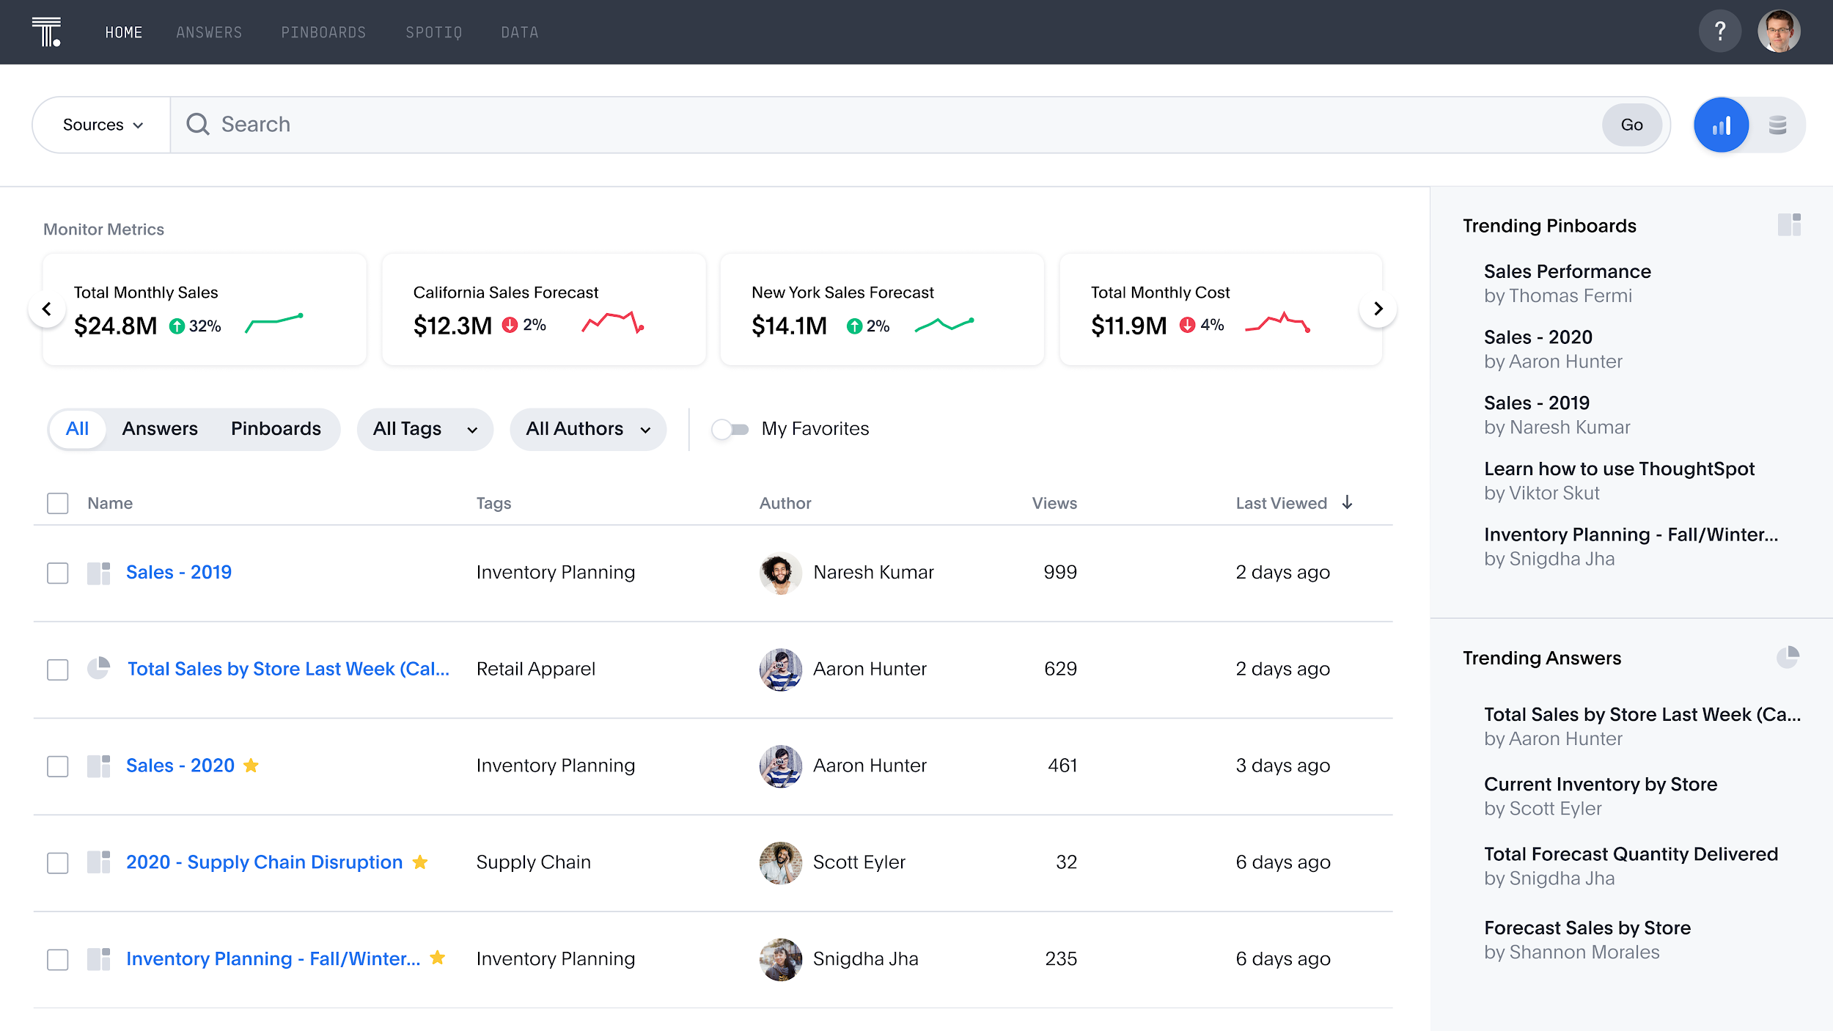
Introducing Search Answers available on ts-cloud
With Search Answers, you can search existing content in Answers and Pinboards to get the information you need. This complements Search Data, where users create new Answers and Pinboards.

Slide 17
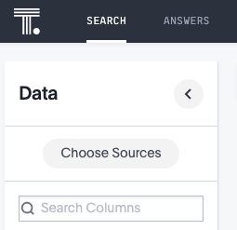
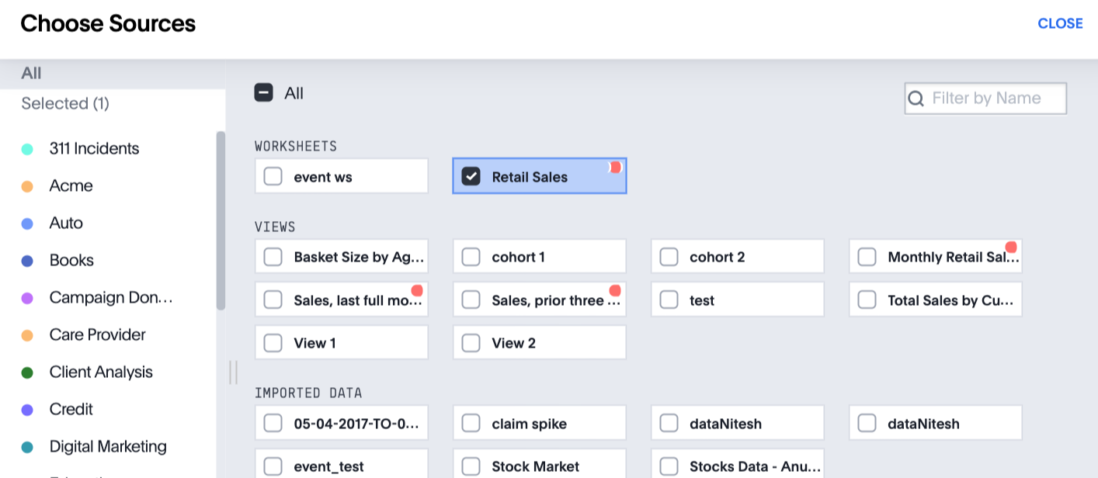
What data do you want to search?
To begin a search, first choose your data source.
You can choose from worksheets, views, imported data, or data tables that are shared with you (or that you upload).
Notes:
Now you want to do a search! To begin a new search, you must first select your data sources by clicking on the Choose Sources button. A Data Search may already be selected for you. Searches happen in the context of the selected data sources. You will see a list of data sources that have been shared with you. The data sources are usually created by your administrator, though users with the Can Upload Data permission can also upload their own data.

Slide 18
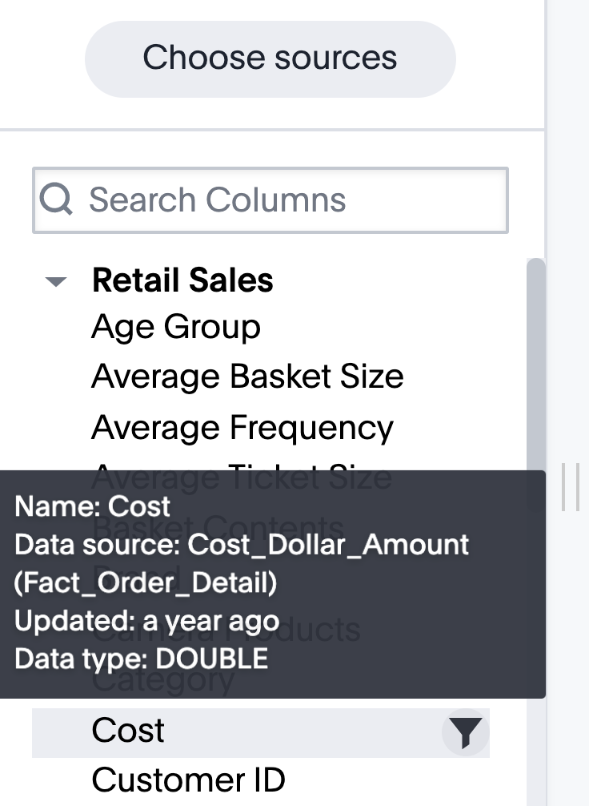
What does this data contain?
Click on the name of the data source name to view columns.
Hover over a column to see description and metadata.
Double click a column name to add it to the search bar.

Slide 19
What can I type in the search bar?
1. Column names
2. Data values (act as filters)
3. Keywords

Slide 20
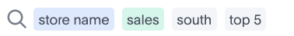
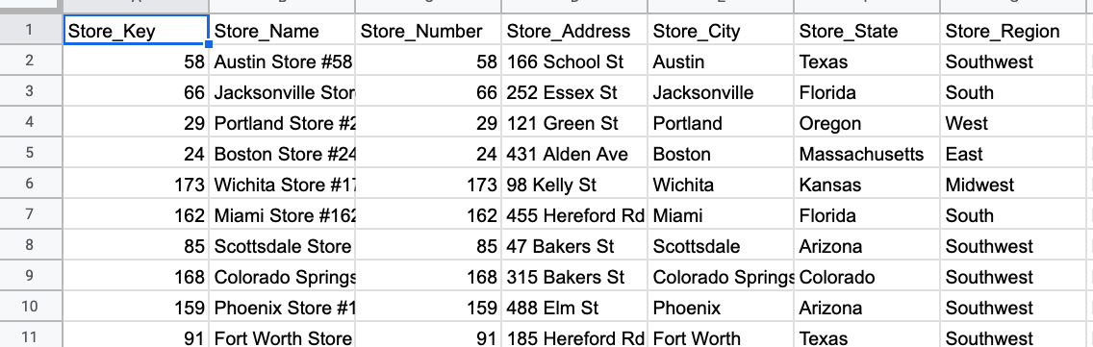
What can I type in the search bar?
Column names
Data values (act as filters)
Keywords
Notes:
As we type column names in the search bar, ThoughtSpot will put a blue box around them. Add a column name to the search bar by double clicking on it from the left data panel, or typing it into the search bar. As you type, ThoughtSpot will make suggestions.

Slide 21
What can I type in the search bar?
Column names
Data values (act as filters)
Keywords
Notes:
You can type a data value directly into a search bar, and it will act as a filter. The answer will only include rows in which that data value is true. Filters appear in gray boxes.

Slide 22
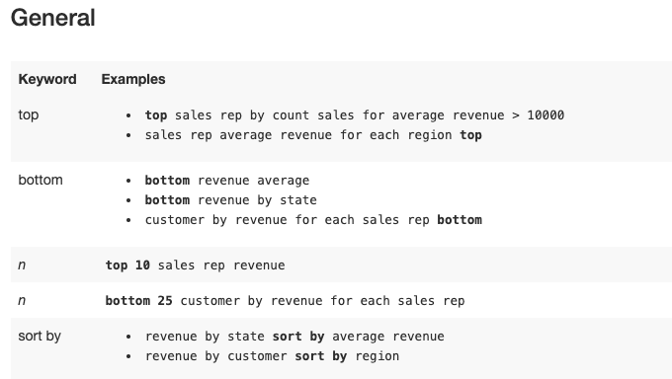
What can I type in the search bar?
Column names
Data values (act as filters)
Keywords
https://docs.thoughtspot.com/5.2/reference/keywords.html
Notes:
You can use keywords when asking a question to help define your search. You can visit ThoughtSpot’s documentation site for a list of built-in keywords here:https://docs.thoughtspot.com/6.0/reference/keywords.html. Examples of keywords are top N, sort by, after, quarterly. Keywords are also translated into a number of other languages, which can be selected in the locale preferences of the user profile. Keywords appear in gray boxes.

Slide 23
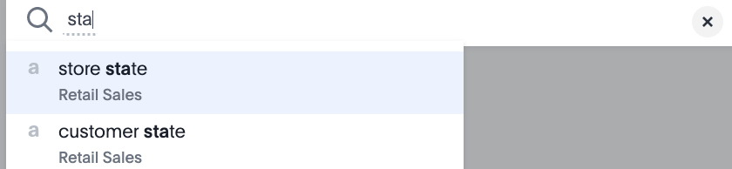
Doing a search
Double click or type a column name to add it to the search bar.
Suggestions may automatically appear; make a selection if needed.
A box appears around each search term. Hover your cursor over a column name, and click X to remove a search term.
Notes:
As you type, ThoughtSpot may provide suggestions of column names or data values that match what you have entered. A box will appear around each search term. Blue boxes appear around column names, while gray boxes appear around filters and keywords. Measures are underlined, while attributes are not.

Slide 24
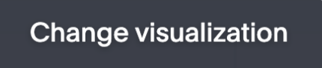
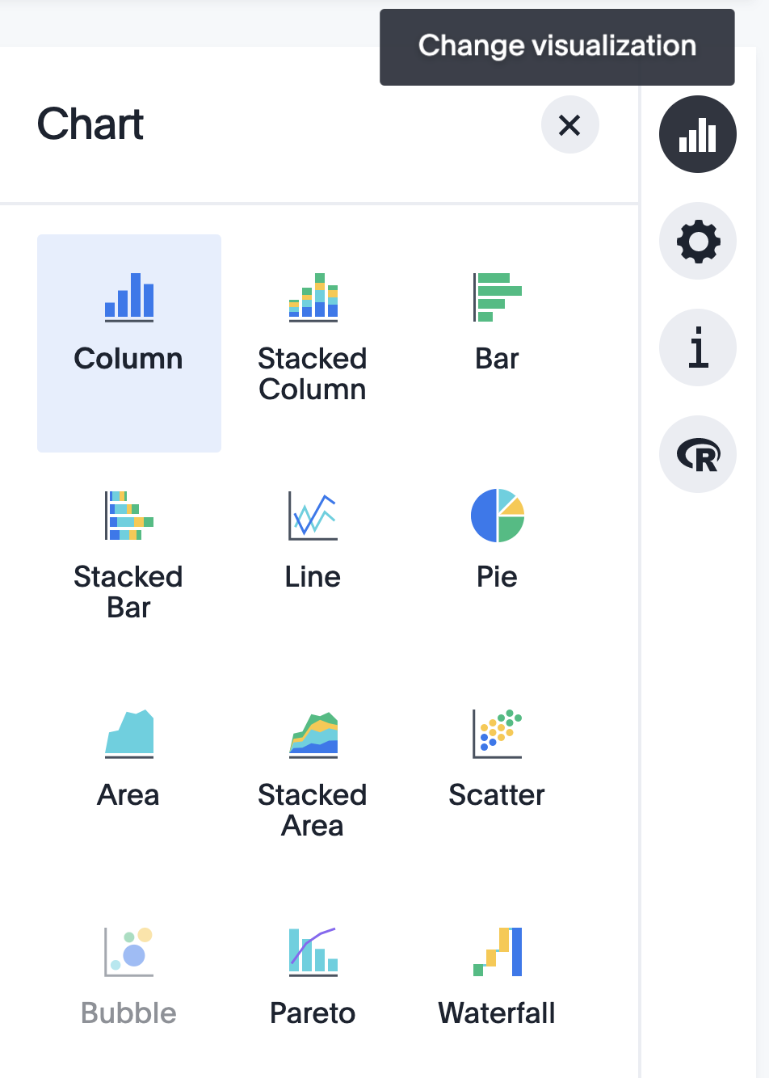
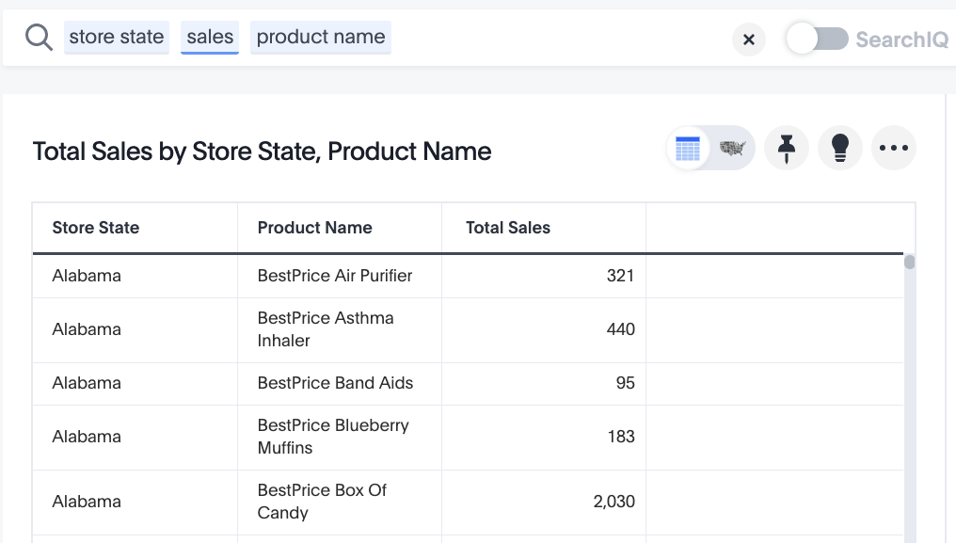
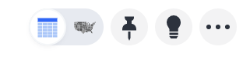
How does a chart get selected?
ThoughtSpot chooses a “best fit” visualization.
You can toggle from table view to chart view, or change the visualization.
Notes:
ThoughtSpot chooses a best fit visualization based on your search. You can toggle between Table and Chart mode. Even though ThoughtSpot initially selects the chart type, you can always change it. You can choose from a large number of chart types in ThoughtSpot. Each chart type provides you with a different visualization for your answer.
Some chart types may be unavailable for you to select depending on the columns in your search. For example, if your search does not contain at least one geographical column, you will not be able to select any of the geo chart types. Unavailable chart types are grayed out. Hovering over one will tell you what columns are needed before you can choose it.

Slide 25
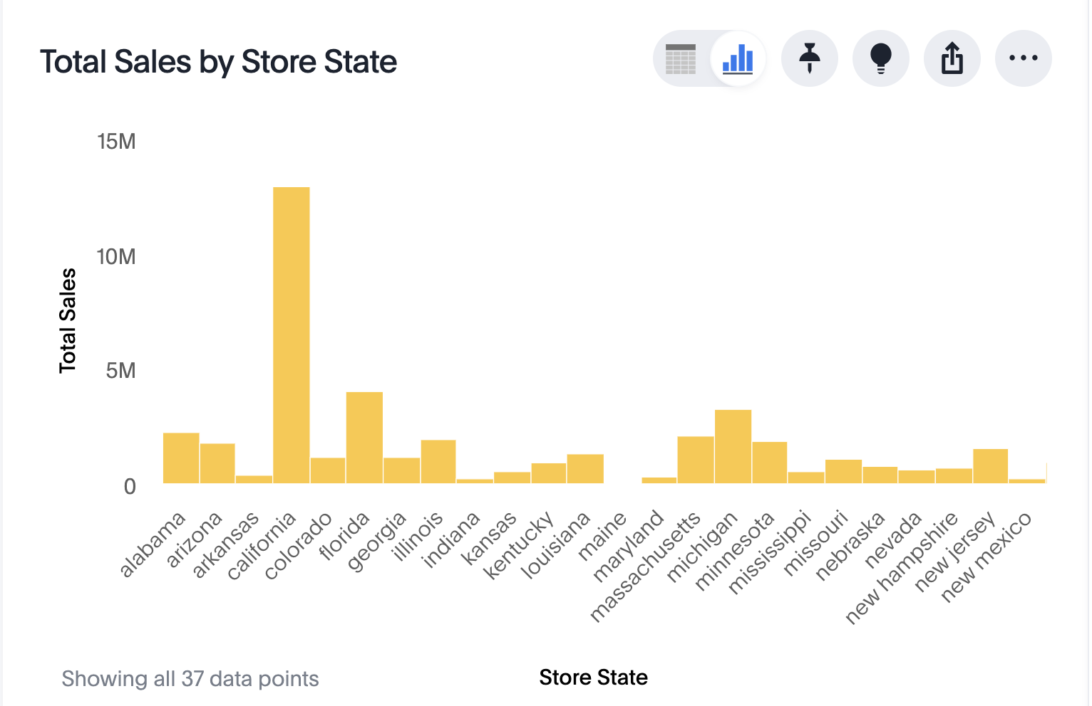
How does a chart get selected?
A chart requires that a measure and an attribute be entered into the search bar.
attribute
measure

Slide 26
Measures vs. Attributes
Measure
Attribute
A measure is a numeric value (that you can do math on).
Examples:
Age, height, weight
An attribute is a text or date value.
Examples:
Hair color, name, occupation
Notes:
To get a chart, you need at least one measure and an attribute. Sometimes it’s not obvious if something is a measure or an attribute. For example, what about a Social Security Number? It looks like a numeric value, but you can’t do meaningful math on it; it is an attribute.

Slide 27
Chart configuration
Notes:
Version 6.0 introduces a complete new approach that makes chart configuration easier and more intuitive.

Slide 28
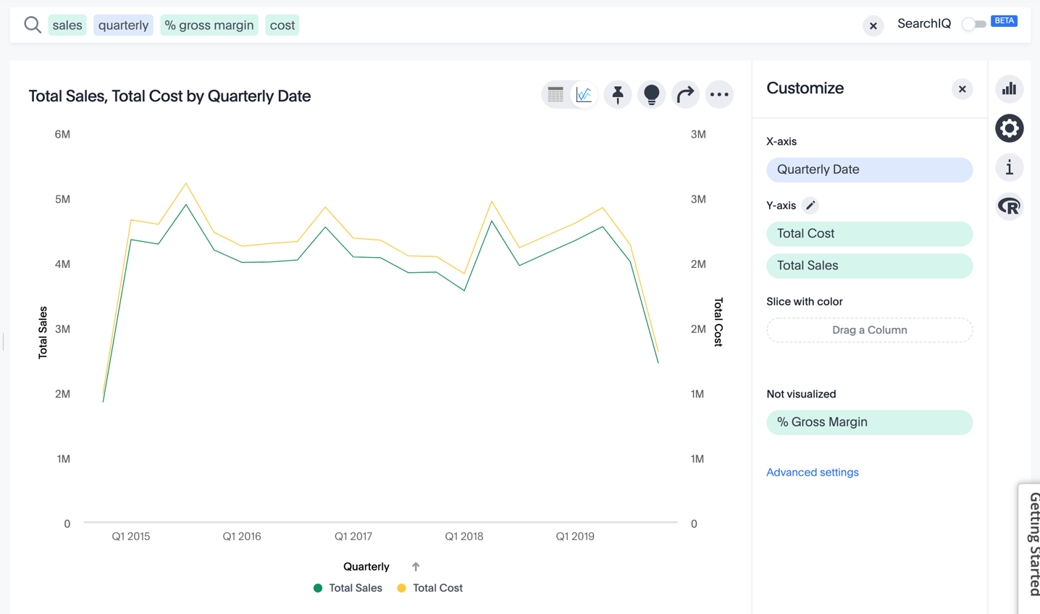
Edit your Chart
Click the Chart Configuration icon to edit your chart easily from Chart Mode.
Click on a colored chip to edit a search item.
Notes:
You can easily view which tokens are visualized, and which aren’t. Drag and drop from the Not Visualized section above, to quickly include or exclude items from search. As you add new elements to the search bar, they appear on the chart as “Not visualized”, and you can move them into the axis area to visualize.

Slide 29
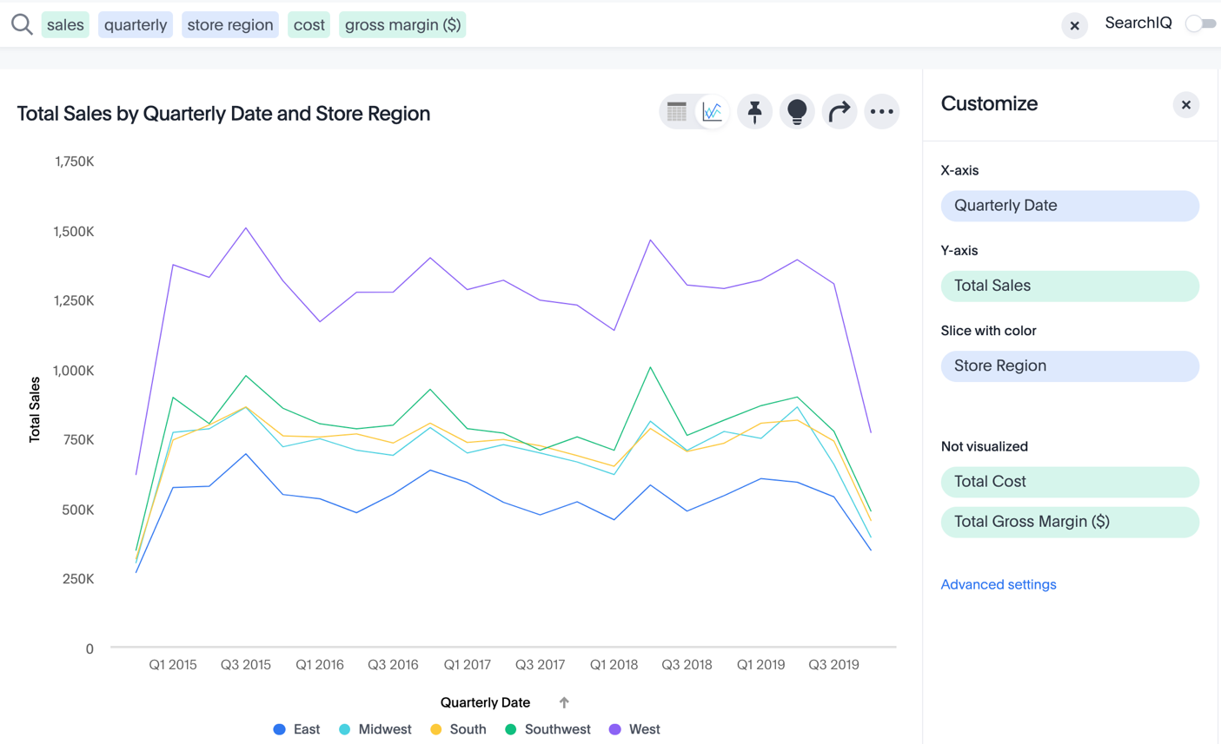
Edit your Chart: Slice with color
Change how data is being sliced in the Slice with color section.
Drag and drop a column name in the Slice with color area.

Slide 30
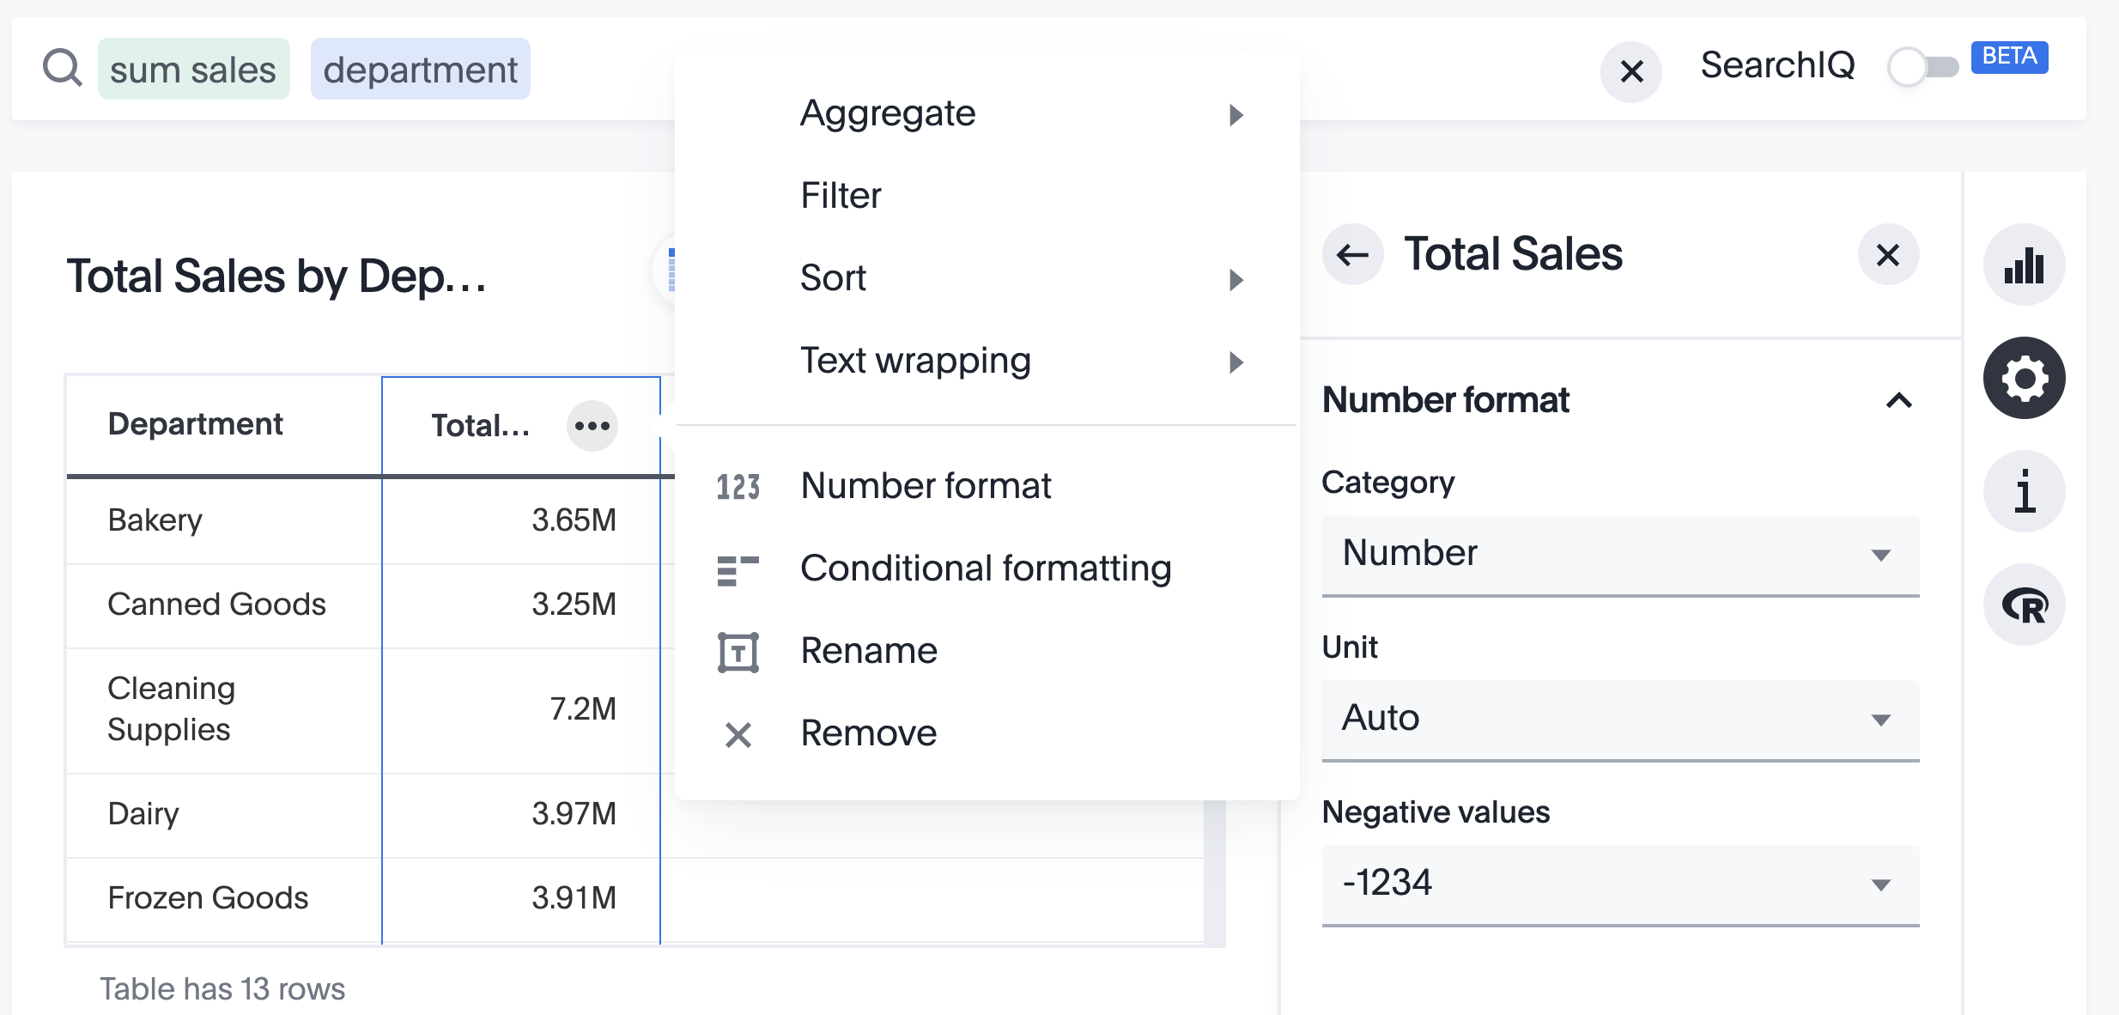
Edit your Chart: Format Numbers
To change number formats, click on the ellipses icon of the metric in table view, or select the metric’s colored chip in the Chart Configuration view.
Notes:
You can edit number formatting for data labels on the chart marks (bars, bubbles, lines), and on the axes. You can change a value to a number percentage, currency, or “as is” (auto mode), or change to millions, trillions, and billions (K, M, B). Specify the number of decimal places.

Slide 31
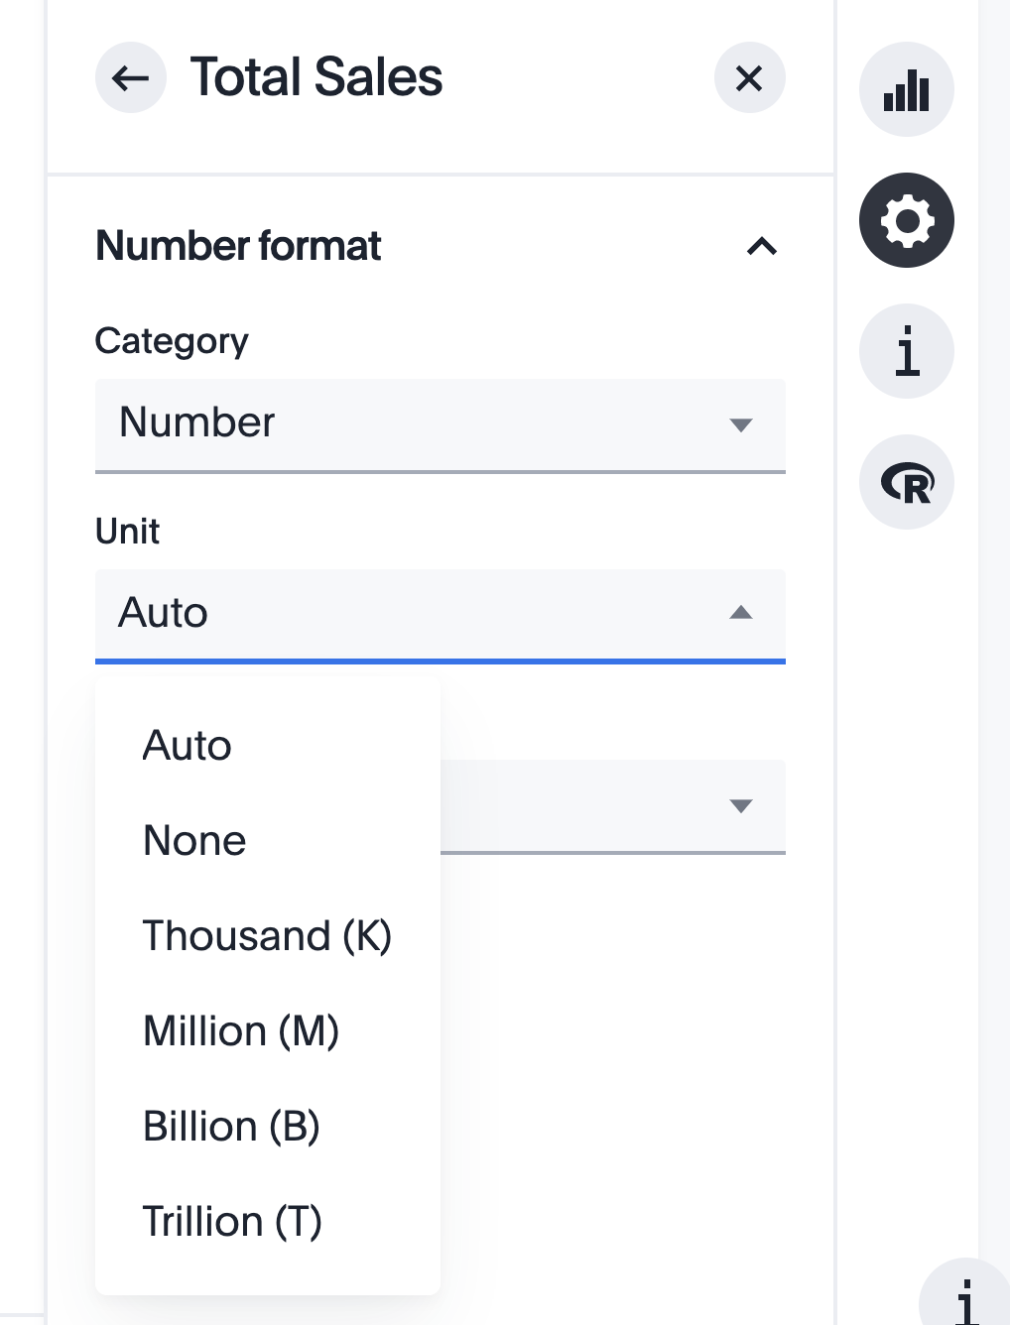
Edit your Chart: Format Numbers
Easily set the units for the metric you’d like displayed.
Independent control for each measure allows you to apply changes only where needed.

Slide 32
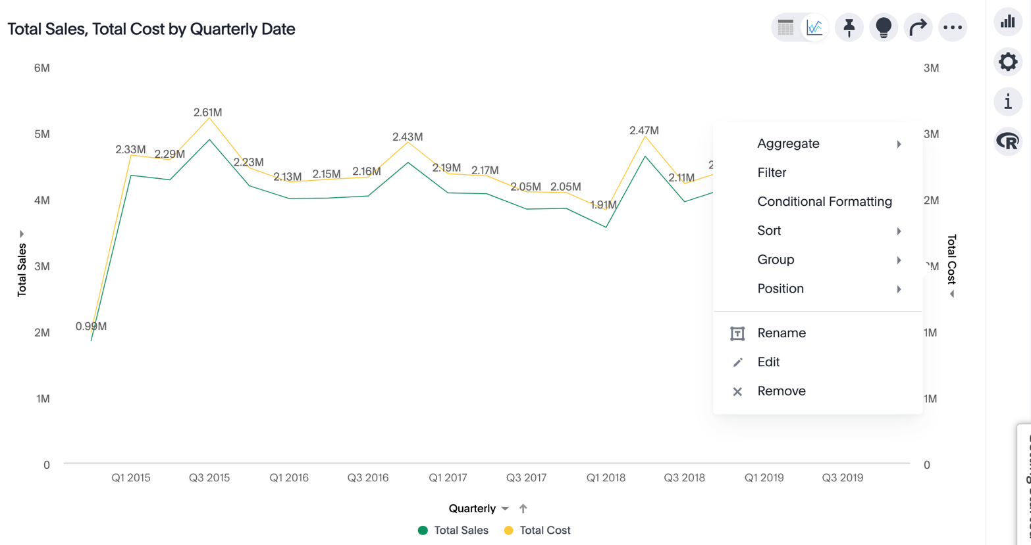
Edit your Chart: Edit an Axis
Click on an axis label to format, re-position, and edit axis labels
Notes:
Click on an axis label to see different formatting options. Here you can group the axis together with a second axis, re-name the label, change its position (left or right), and even change the aggregating operator.

Slide 33
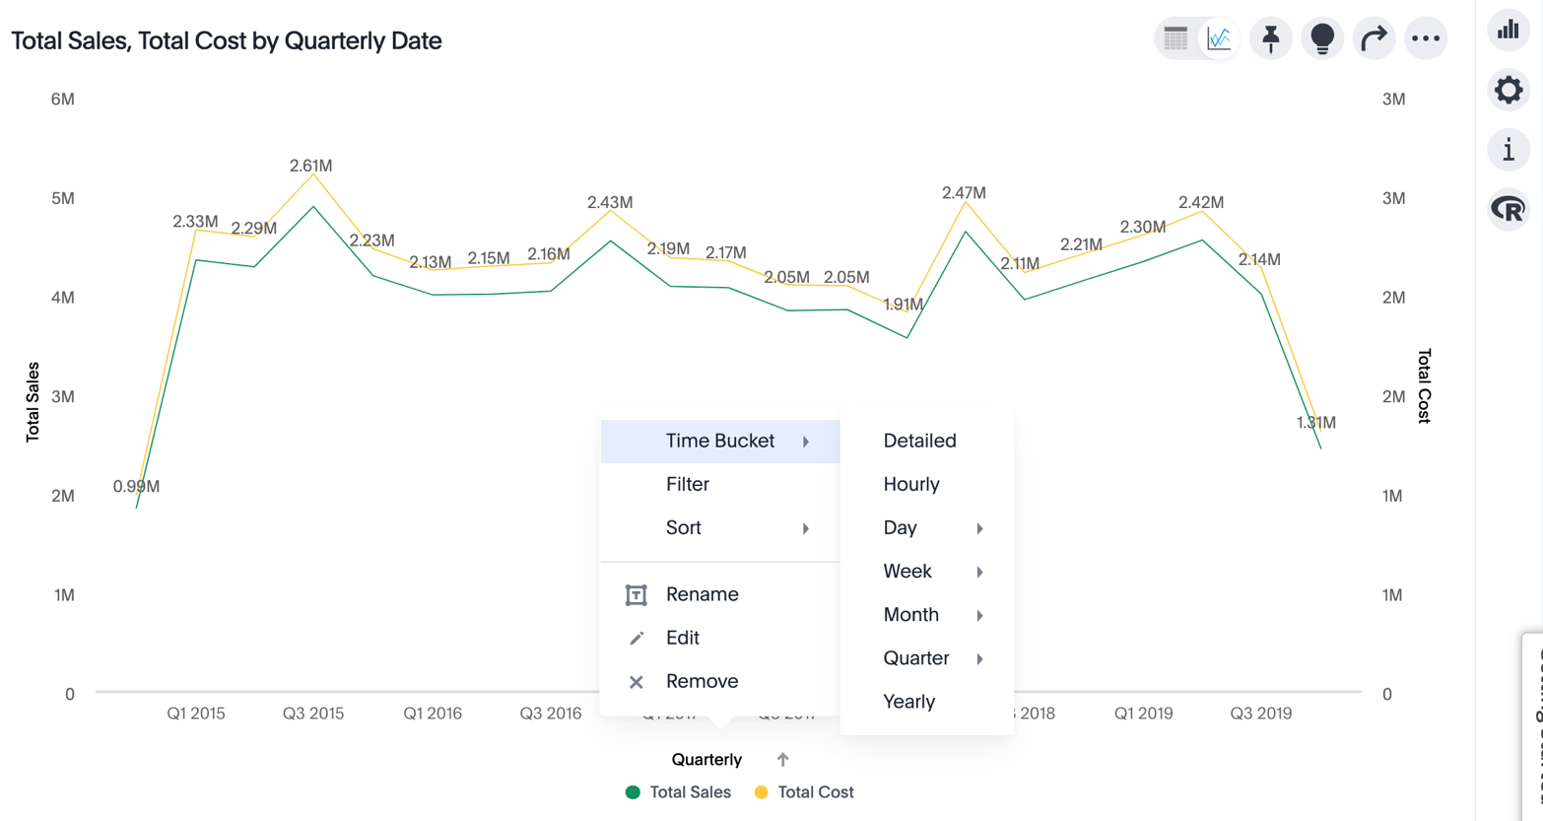
Edit your chart: Change Time Bucket
Click on an axis label to change the time bucket for the chart.
Notes:
You can even change the time period in which your data is being viewed by, from Chart Mode. Click on the axis label of your time column to change the granularity of your time series.

Slide 34
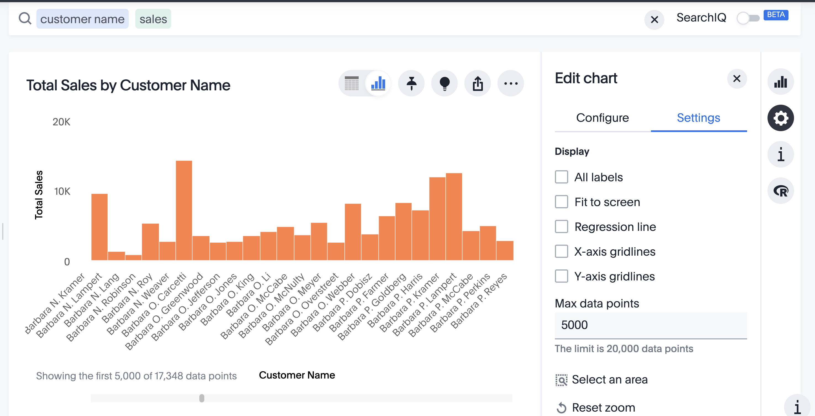
Edit your chart: High Cardinality
Visualize up to 30,000 data points on a chart.
Un-check Fit to screen, and use scrollbar to scroll horizontally and view all data points.
Notes:
The maximum number of data points that can be visualized is configurable via tscli. You can choose 1,000 points for compatibility with pre-6.2 functionality, or set any limit up to 30,000. ThoughtSpot recommends 20,000 as the default.

Slide 35
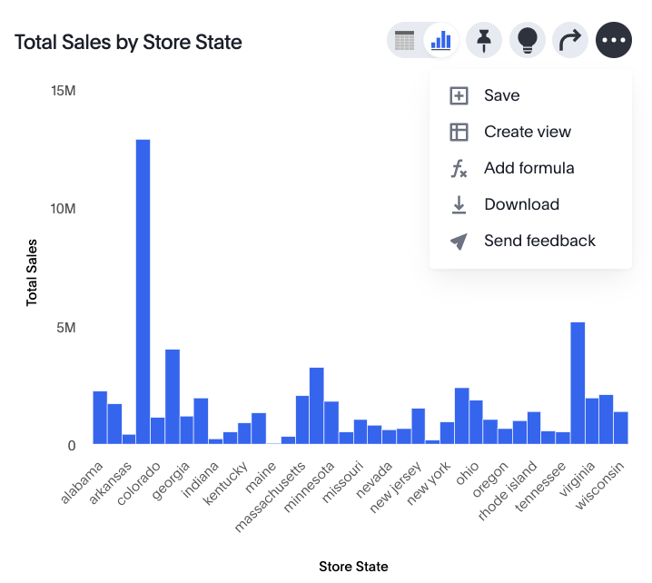
Saving your Answer
Click the ellipsis icon to save your Answer.
“Create View” to save your Answer as a data source.
Notes:
Save your Answer if you want to refer to it later. If you leave the search page and return, your search is gone unless you save it. If you want to search on top of another search, you can save your search as a View. Then, you can use the View as a data source for a new search.

Slide 36
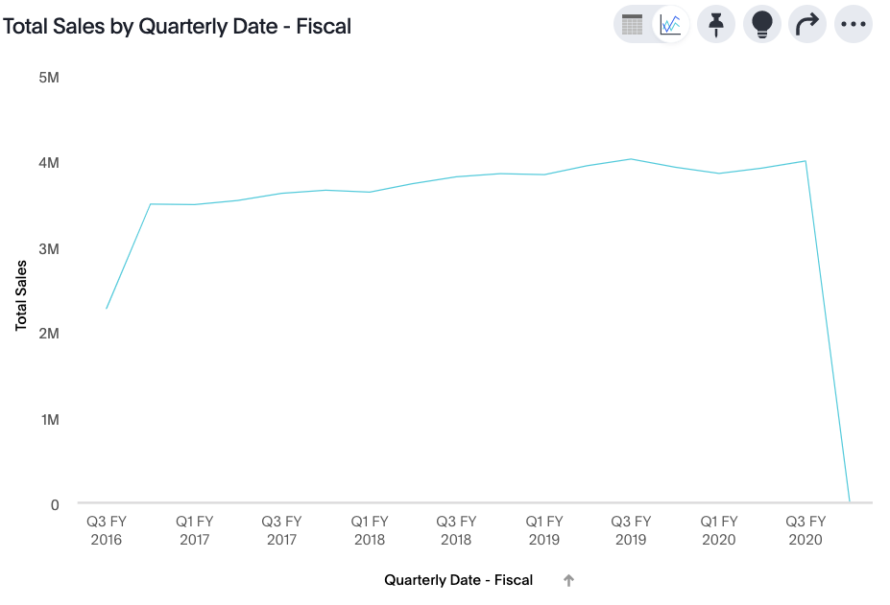
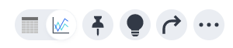
Pin a chart to a Pinboard
While viewing an answer, click the Pin icon at the top right of the answer
Pin to an existing Pinboard, or create a new Pinboard.
Notes:
Save a search to a Pinboard by clicking the Pin icon at the top right of the Answer. You can either save it to an existing Pinboard, or create a new one.

Slide 37
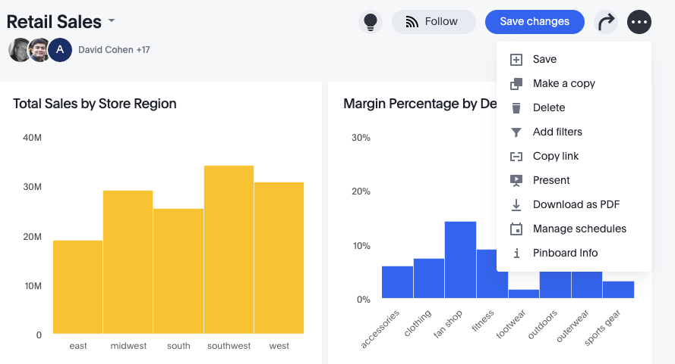

Slideshow from a Pinboard
Answer audience questions during a presentation by turning your Pinboard into a slideshow.
Notes:
You can present your Pinboard as a slideshow, and turn your Pinboard into an interactive presentation. You can easily explore and answer questions from the audience during the presentation. Each visualization is displayed as a slide, and you can Drill Down, run SpotIQ, Show Underlying Data, and Filter within the presentation. Use your arrow keys of the keyboard to navigate the presentation.

Slide 38
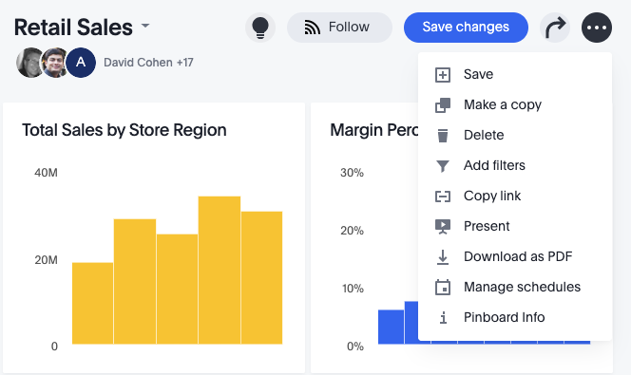
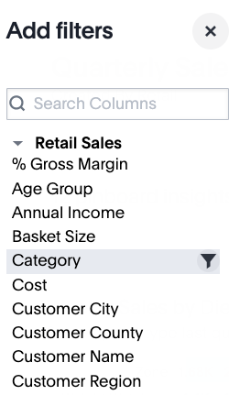
Pinboard Filters
Pinboard filters work like normal filters, and apply to all or some objects on that Pinboard.
You can view and change the filters using the filter list.
Notes:
Filters, including bulk filters and exclude filters, can be applied to Pinboards just as with tables and charts. These kinds of filters apply to an entire Pinboard, making it easy to see only the data that you are interested in across the tables and charts within a pinboard. Use the Configure Filters option to apply filters to only select objects on the Pinboard. You can narrow the focus of your Pinboard for specific purposes or audiences.
When you apply a filter, the filter is not automatically saved on your Pinboard to encourage ad hoc filtering.
If you filter a Pinboard on a column that was already filtered on the Answer level, the Pinboard filter overrides the Answer filter.

Slide 39
Favorites

Slide 40
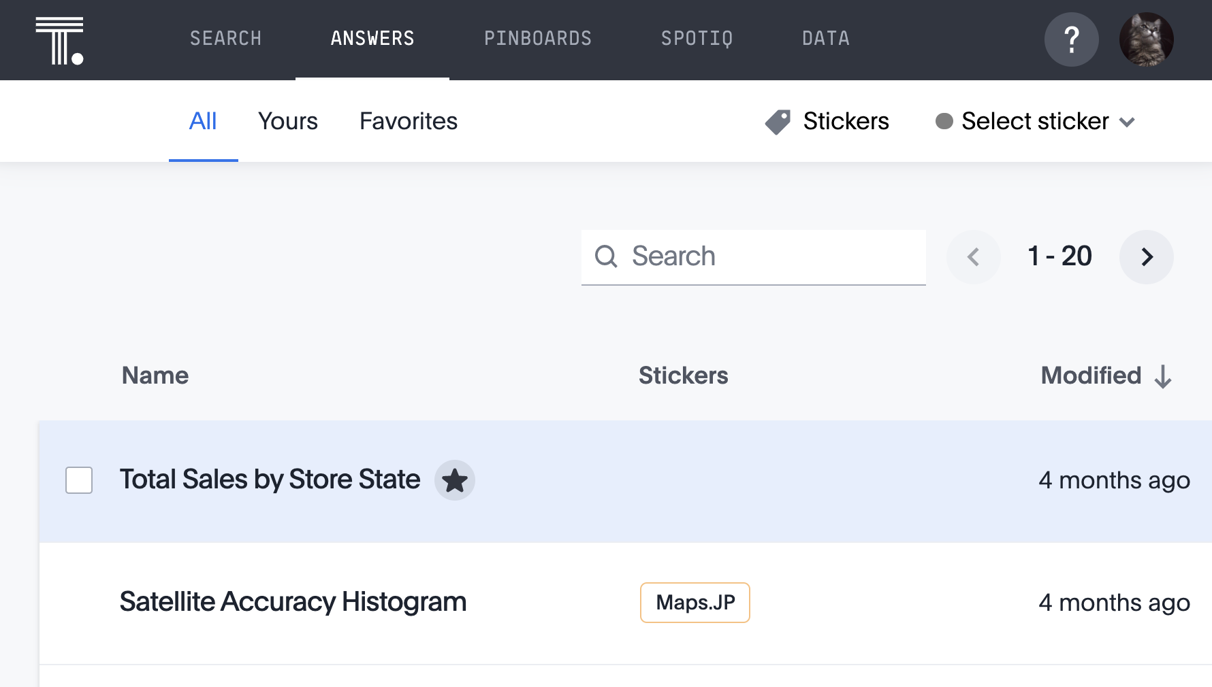
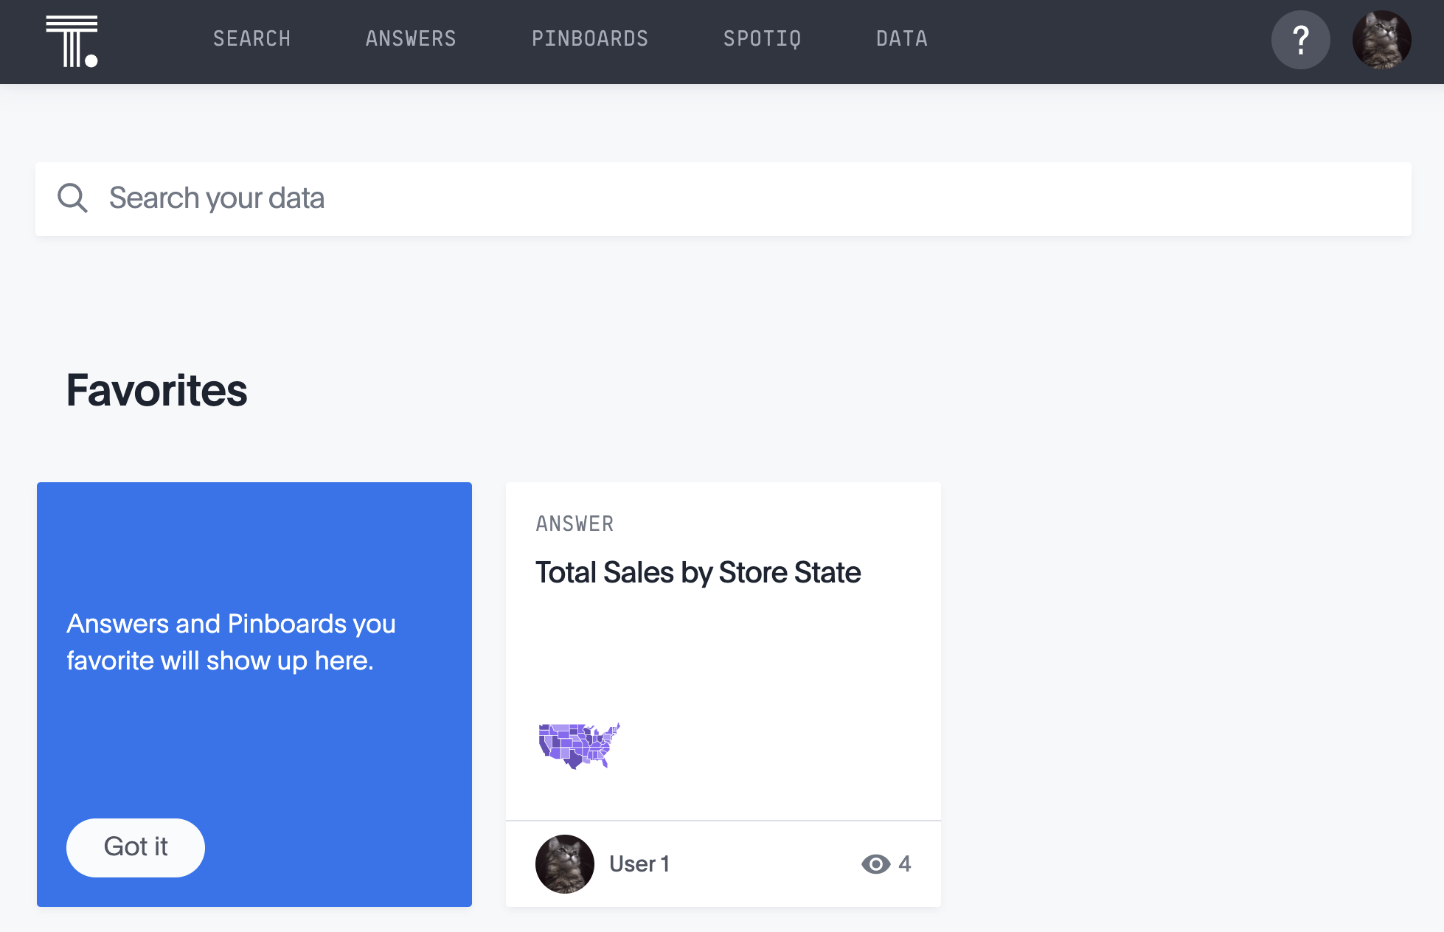

Favorites
Use Favorites to find Pinboards and Answers quickly. Click on the Favorite icon of an Answer or Pinboard and it will be added to the Favorites list on the Answers and Pinboard pages, as well as on the ThoughtSpot home page.
Favorite an Answer or Pinboard by clicking the star.
See it on your ThoughtSpot home page
Notes:
Hover over an Answer or Pinboard for the Favorite icon to appear. Favorites are also available on ThoughtSpot’s mobile app for iOS. It is a quick and easy way to retrieve identified answers and pinboards, for access on the go.

Slide 41
Drill Down and Show Underlying Data

Slide 42
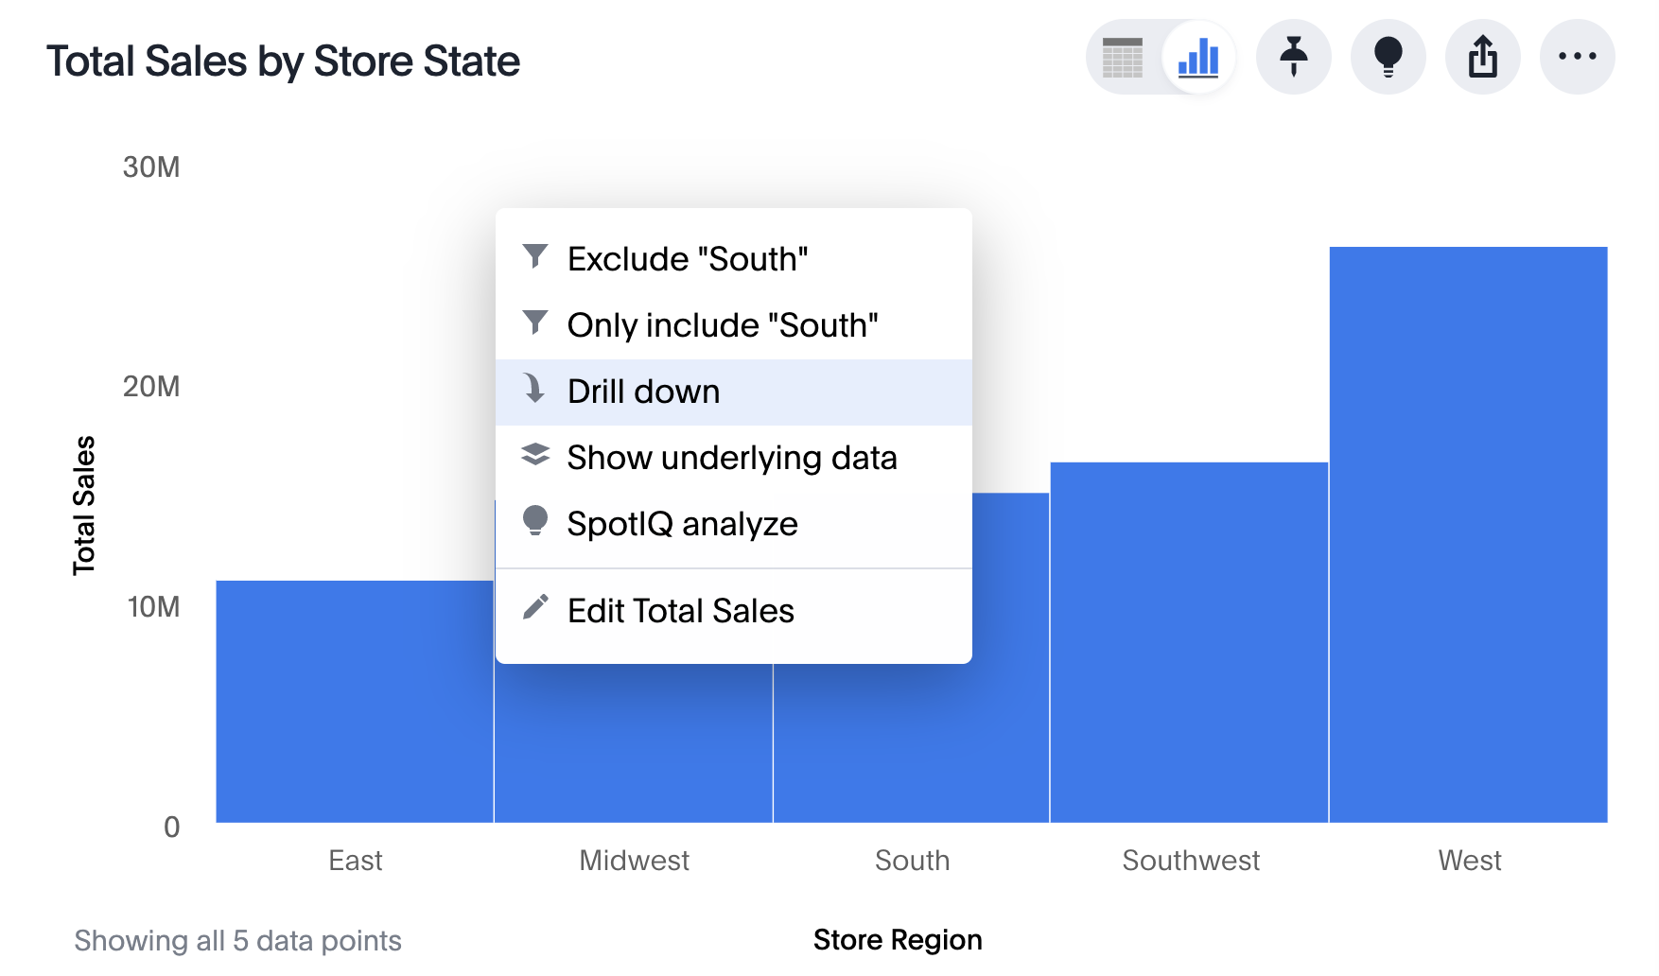
Drill Down
ThoughtSpot allows you to drill deeper in a search from Chart mode.
Right click on a data point of interest, and click Drill down
Notes:
You can use your answer to learn more about the data used in your search by drilling down. Drilling down allows you to see more information about the columns within your search. If you own the Pinboard, you can drill down to the data beneath. Users you share the Pinboard with can also drill down, provided they also have access to the data on which the board was based.
To drill down, right-click the visualization or table cell of interest, and select Drill down. Then, click any of the listed data dimensions to recreate the search with that data included.

Slide 43
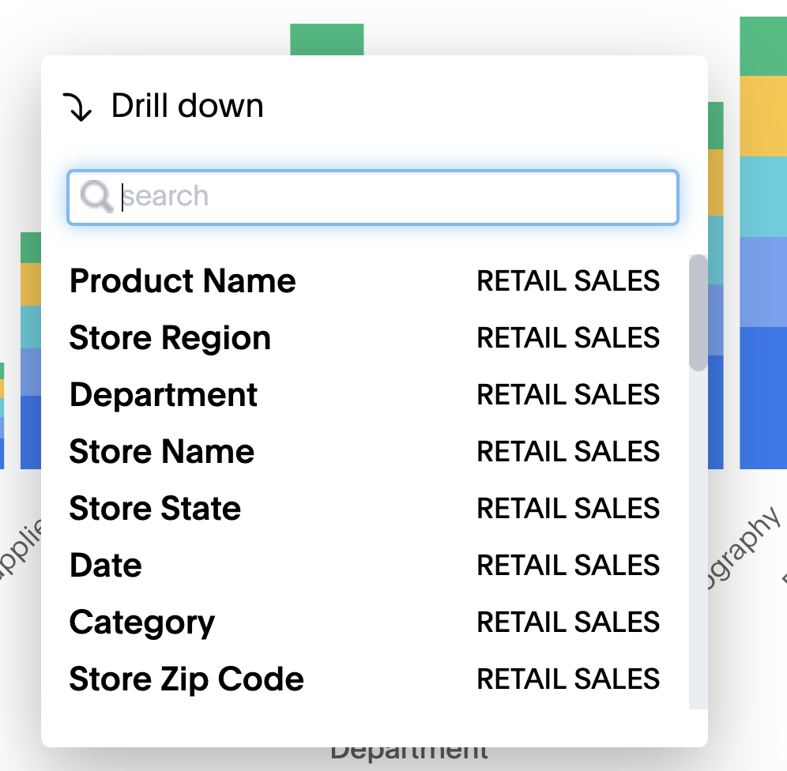
Drill Down (Continued)
After clicking Drill Down, select the dimension you want to drill on.
Notes:
ThoughtSpot suggests columns for you to drill down on.

Slide 44
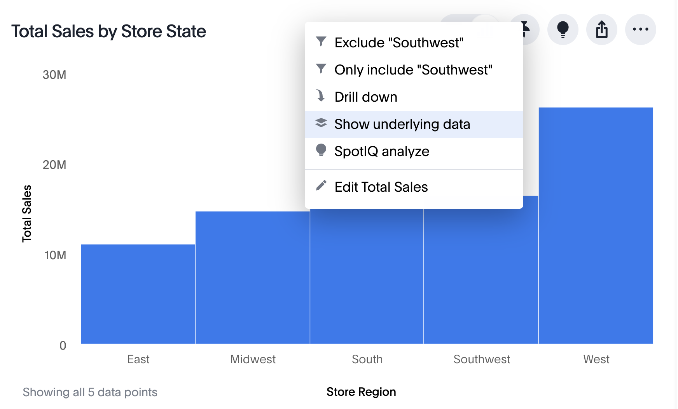
Show underlying data
ThoughtSpot allows you to show a chart’s underlying data, from Chart mode.
Right click on a data point of interest, and click Show Underlying Data.
Notes:
You can see the most granular details of a given result set, in an unaggregated view, when you select Show Underlying Data. This feature lets you understand what an answer consists of. Only the first 1,000 rows are shown when viewing the underlying data. You can even download the results shown when you choose Show underlying data from a chart. The download file limit is a million rows.

Slide 45
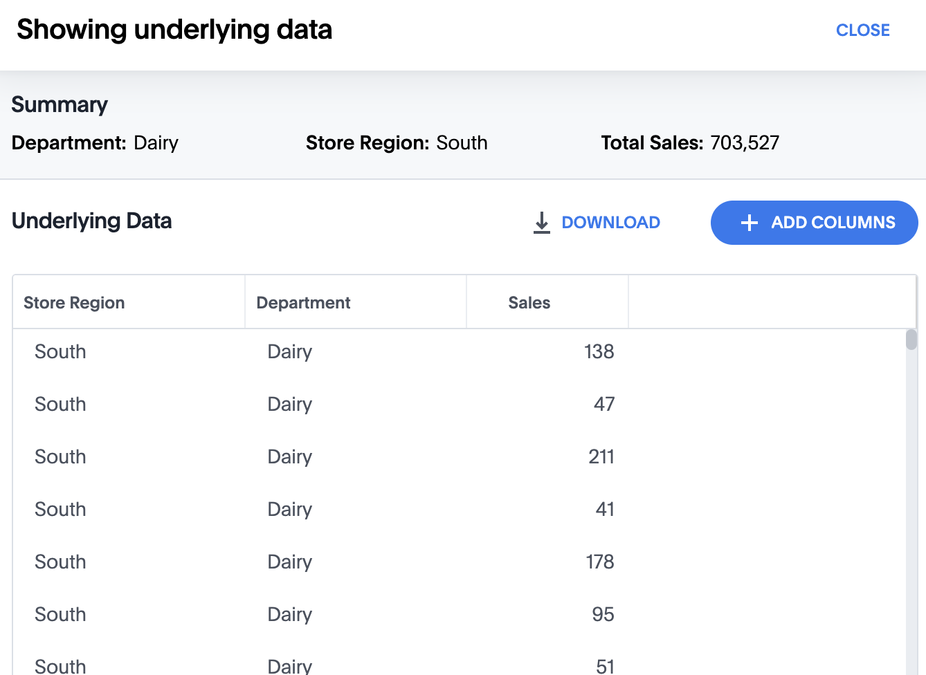
Show underlying data (Continued)
ThoughtSpot allows you to show a chart’s underlying data, from Chart mode.
Add additional columns to the underlying data table
Notes:
You can see the most granular details of a given result set, in an unaggregated view, when you select Show Underlying Data. This feature lets you understand what an answer consists of. Only the first 1,000 rows are shown when viewing the underlying data. You can even download the results shown when you choose Show underlying data from a chart. The download file limit is a million rows.

Slide 46
Filters

Slide 47
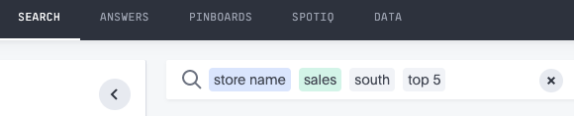
Filters
A filter narrows down the results to only include what you want to see.
When you type a data value to your search, it becomes a filter.
Filters appear in grey in the search bar.
Notes:
When you add a value to your search, it becomes a filter. You can define filters on tables, views and worksheets. When you add a filter, it is applied to the table, view, or worksheet, so the result set only shows rows that satisfy a set of parameters specified in the filter. You can also set filters that are automatically used in every search you perform using a particular data source.

Slide 48
There are multiple ways to filter
Filter in search bar
Filter in bulk
Filter from list
Filter from left panel
Filter by date
Notes:
When you add a data value to your search, it becomes a filter. You can define filters on tables, views and worksheets. When you add a filter, it is applied to the table, view, or worksheet, so the result set only shows rows that satisfy a set of parameters specified in the filter.
In this example, ”south” is a data value in the Store Region column, so a user will only see data for the south Store Region.

Slide 49
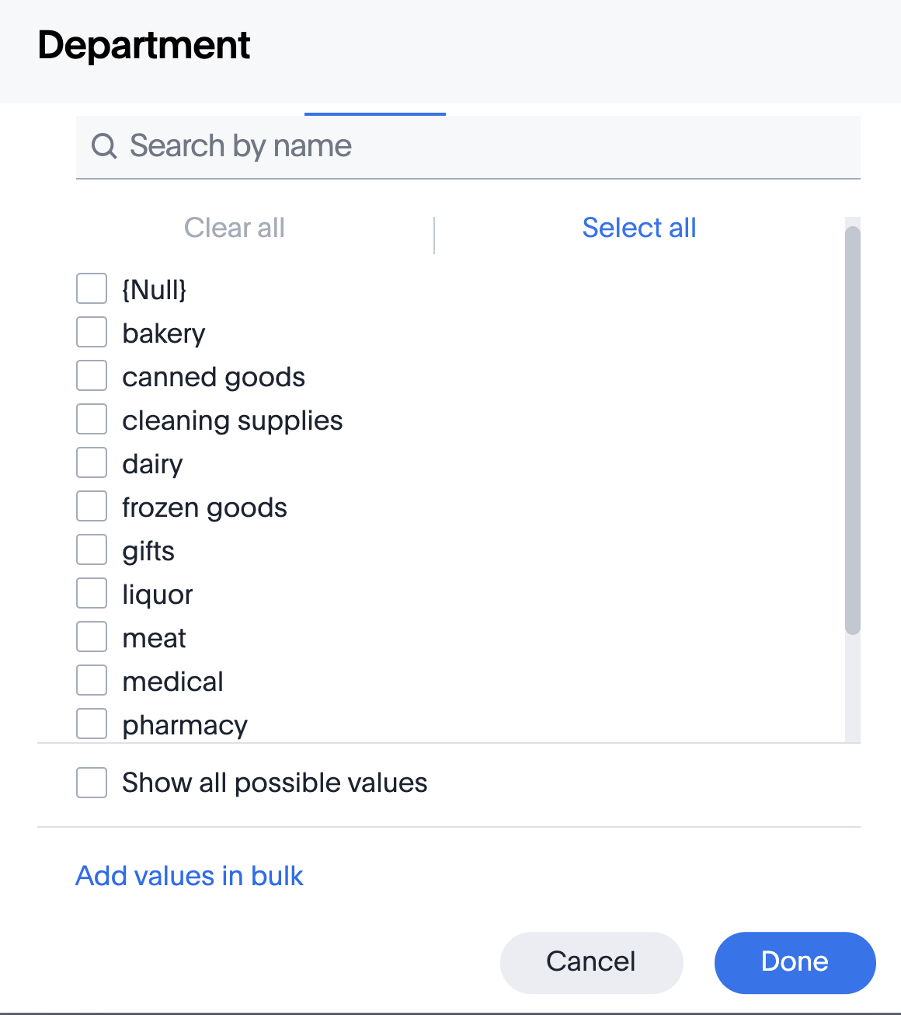
There are multiple ways to filter
Filter in search bar
Filter in bulk
Filter from list
Filter from left panel
Filter by date
Notes:
If you have a large worksheet or table with thousands or millions of rows, you may want to create bulk filters. You can paste in a list of filter values to include or exclude, instead of clicking the box next to each value in the filter selector. Bulk filters can be very useful when you have a very large worksheet or table. You can use them to filter a large list of values easily. For example, this is useful if you want to only search on a list of products that your manager sent to you in an email. You can cut and paste those values into the bulk filter box to quickly generate a report or chart that includes only those items of interest.
You can create a bulk filter by pasting a list of values, separated by commas, semicolons, new lines, or tabs, into the bulk filter box. This allows you to easily search a large list of filters repeatedly.

Slide 50
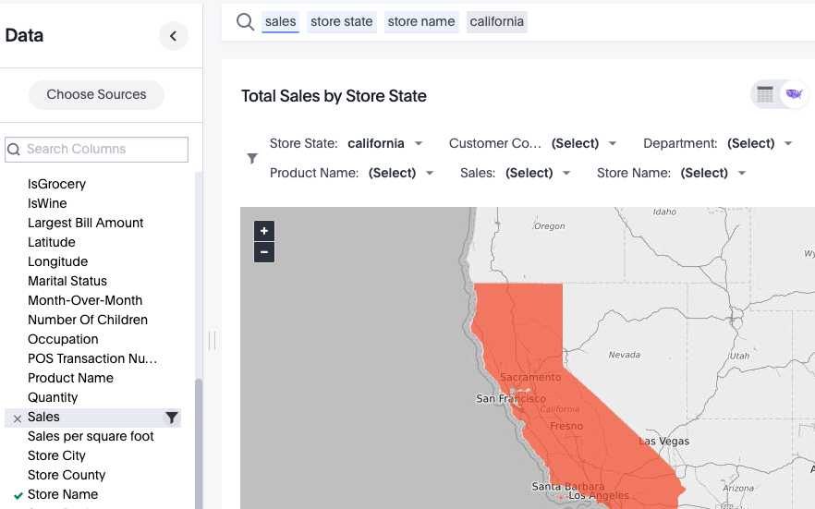
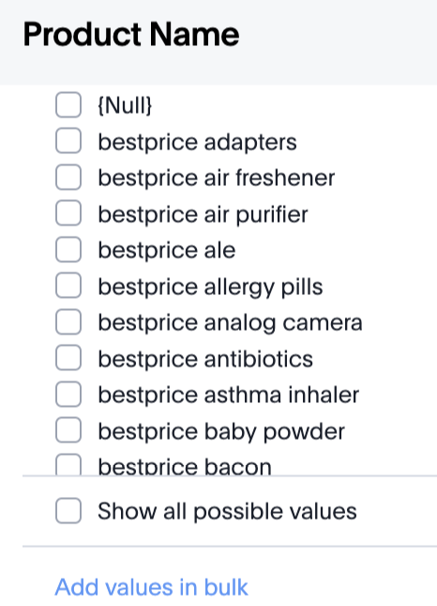
There are multiple ways to filter
Filter in search bar
Filter in bulk
Filter from list
Filter from left panel
Filter by date

Slide 51
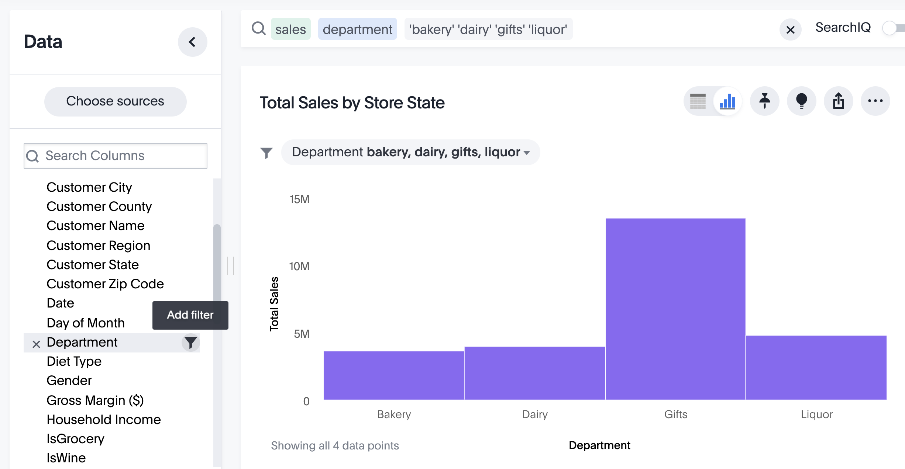
There are multiple ways to filter
Filter in search bar
Filter in bulk
Filter from list
Filter from left panel
Filter by date
Notes:
Hover your cursor over a column in the left data panel to view the filter icon. Select the filter icon to see a list of data values, and select which to include or exclude.

Slide 52


Date Filters
Filter in search bar
Filter in bulk
Filter from list
Filter from left panel
Filter by date
You can use the date picker when filtering on a date column.
You can also filter with date keywords. (Ex: yesterday, this year, after)
Notes:
The keyword reference of the documentation site includes section of all date keywords that you can filter on. https://docs.thoughtspot.com/6.0/reference/keywords.html

Slide 53


When search has multiple possibilities
If your search has multiple possibilities, confirm that the correct column has been selected.
Notes:
When there are more than one possible meaning for a search term, you can provide disambiguation by selecting from a list of choices. Now, your choice is sticky. That means you won’t have to select it again, in the scope of the current search.
Usage based ranking dictates the order that these options appear. If it’s the first time, ThoughtSpot might ask “You typed West- do you mean something else?” but if you have used it before, it may select the one you have used most often.

Slide 54
Need Help? Ask an Expert

Slide 55




Ask An Expert
Users can get help from subject-matter experts in their organization when they need help with their search, or want to validate a chart or table.
Notes:
At times you may struggle to answer a specific question, build a chart you have in mind, or find something in your data. You can use Ask an Expert to request help from someone in your organization. Your request will go to the person in your company who best knows the data source you’re using and how to search it in ThoughtSpot. When your request is answered, you will be able to see the result in the Answers listing in ThoughtSpot.
You can get an answer to your tough question, even when you’re stuck. The expert gets to see what people have trouble with, so he or she can make it easier. You can use the answer from the expert to understand the data better.

Slide 56


Ask An Expert: Manage your requests
After you submit requests, expert(s) will be notified via email.
You can view and manage the requests that you have submitted in the Expert Requests link of the Help icon.
Notes:
An expert, or multiple experts, can be added for a data source, which could be a data table, worksheet, or view. When a request is sent, the expert(s) will receive an email, which will provide them a link to the answer in question and the message from the requestor. The expert can then address the inquiry.
Users are able to create requests that contain queries, details, and the associated chart or table. They can also manage their requests and see the request status, delete the request, and receive email notifications. Experts, on the other hand, can see a list of their requests, fix the chart or table in question, mark the request as resolved, and receive email notifications.

Slide 57
Mobile

Slide 58

ThoughtSpot mobile
Home Pinboards Add charts and tables to a customizable Home Pinboard. Quick Share Share KPIs and charts using iMessage, email, and Slack (supports deep linking). Offline Exploration Access your Home Pinboard even when you are offline. Responsive & Interactive Experience Tap and swipe to see chart details. Filter to pinpoint relevant insights. Favorites Tag your favorite Pinboards and Answers for quick access.
Notes:
ThoughtSpot mobile app allows you to discover insights in seconds from billions of rows of data, right from the palm of your hand. You can access your ThoughtSpot cluster to search Answers and Pinboards. You can also create Pinboards using existing answers and use Pinboard filters. Version 2.0 supports more features that were previously available only through the ThoughtSpot Web app, including deep linking and drill down.
Requirements: User account on a ThoughtSpot cluster running version 5.1 or later, and Apple iOS version 9.0 or later (iPad and iPhone) or Android 6.0 or later.

